Slide 1



One Problem, Two Success Criteria WCAG 2.1, Sausage Making, and a Carrot & Stick (A Case Study)
508
#CSUNATC18
AUDIT
ARIA
ADA
WCAG

Slide 2
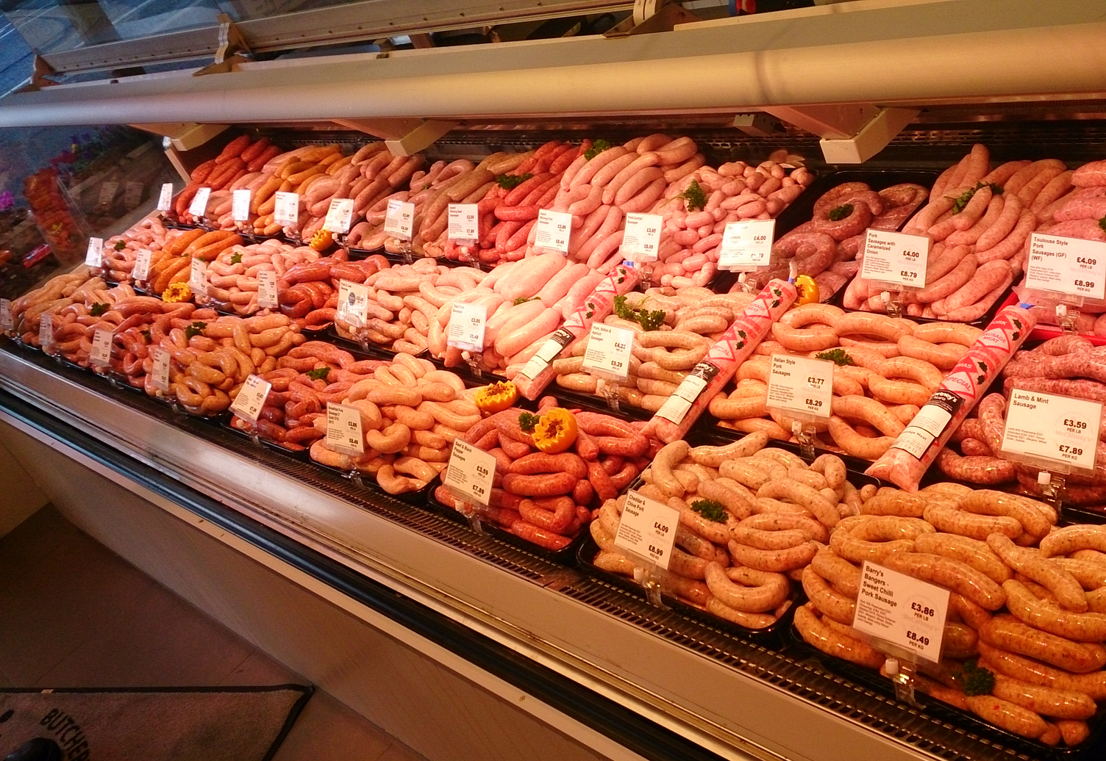
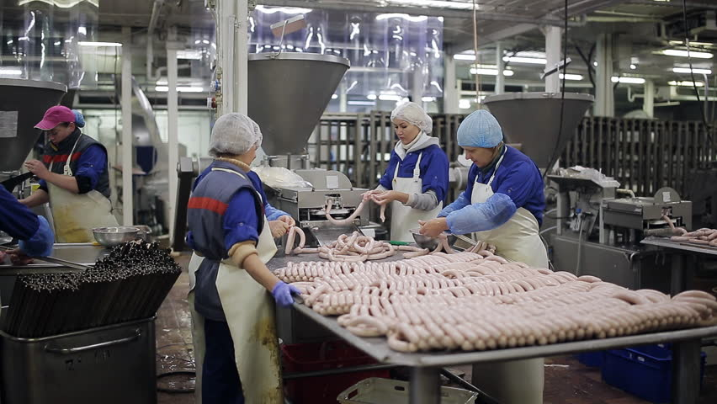
Not Everyone Wants To Know How They Are Made
Everybody Loves Sausages

Slide 3
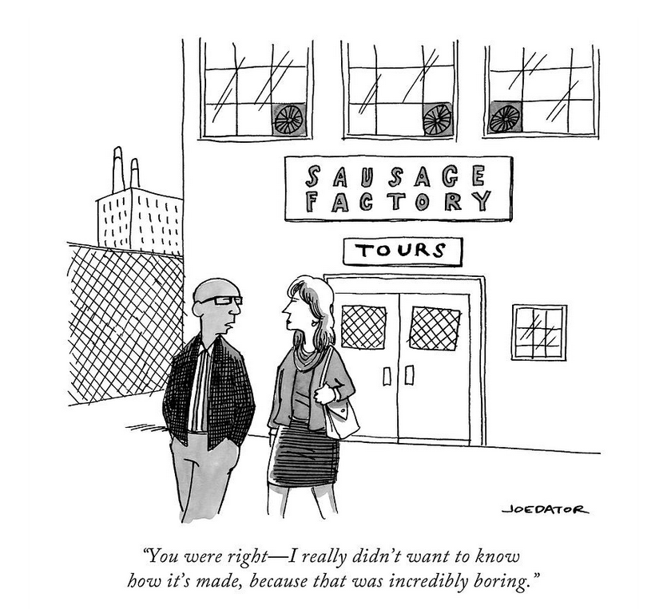
Touring the Sausage Factory
Introducing the Players
W3C
WAI
WCAG WG ➔ AG WG
Mobile Accessibility Task Force
Low Vision Task Force
COGA Task Force
Project Silver Task Force
ePub

Slide 4

What the Future Holds
Project Silver
2 - 7 years (tbc)
WCAG 2.X
2.1 – June, 2018
2 year cycles (tbc)

Slide 5


AG = Accessibility Guidelines

Slide 6
WCAG 2.1

Slide 7

Requirements for WCAG 2.x
Backwards Compatibility
Maintain the POUR Principles
Continue to use the A/AA/AAA Severity model.
Define a clear conformance model
Harmonization of Success Criteria
Meet identified Milestone Dates
February 2017: First Public Working Draft for WCAG 2.1
January 2018: Candidate Recommendation for WCAG 2.1
June 2018: WCAG 2.1 Recommendation
https://www.w3.org/WAI/GL/wiki/WCAG_2.1_Requirements_Draft

Slide 8

The Paperwork (W3C Process)
To publish a Candidate Recommendation, in addition to meeting the general requirements for advancement a Working Group:
must show that the specification has met all Working Group requirements, or explain why the requirements have changed or been deferred,
must document changes to dependencies during the development of the specification,
must document how adequate implementation experience will be demonstrated,
must specify the deadline for comments, which must be at least four weeks after publication, and should be longer for complex documents,
must show that the specification has received wide review, and
may identify features in the document as "at risk". These features may be removed before advancement to Proposed Recommendation without a requirement to publish a new Candidate Recommendation.
BLAH
BLAH
BLAH

Slide 9
WCAG 2.1 CR Exit Criteria
At least 5 conforming Web sites are available, of which:
At least four conform at level AA
At least one conforms at level AAA;
At least one conforming site relies on one platform (Operating system, user agent, assistive technology) with touch screen and small screen support.
At least two implementations exist for each success criterion added in WCAG 2.1 (Success Criteria from WCAG 2.0 do not need new implementations);
Accessibility support documentation is provided such that:
Evidence of successful implementation is available for SC added to WCAG 2.1.
Documentation is provided for at least four platforms (operating system/user agent/assistive technology combinations).
All Sufficient Techniques listed in Understanding WCAG 2.1 at the end of the Candidate Recommendation period contain test procedures;
The Working Group has responded formally to all issues raised against this document related to any implementation efforts during the Candidate Recommendation period.

Slide 10
Severity Levels: A, AA, AAA
whether the Success Criterion is essential (in other words, if the Success Criterion isn’t met, then even assistive technology can’t make content accessible)
whether it is possible to satisfy the Success Criterion for all Web sites and types of content that the Success Criteria would apply to (e.g., different topics, types of content, types of Web technology)
whether the Success Criterion requires skills that could reasonably be achieved by the content creators (that is, the knowledge and skill to meet the Success Criteria could be acquired in a week's training or less)
whether the Success Criterion would impose limits on the "look & feel" and/or function of the Web page. (limits on function, presentation, freedom of expression, design or aesthetic that the Success Criteria might place on authors)
whether there are no workarounds if the Success Criterion is not met

Slide 11
Descriptive vs. Prescriptive
Success Criteria describe a required condition or outcome.
Success Criteria must be measurable and testable
Success Criteria should avoid being overly prescriptive.
Example: Success Criterion 1.1.1 Non-text Content
(Level A)
All non-text content that is presented to the user has a text alternative that serves the equivalent purpose, except for the situations listed below.
Techniques: alt=, aria-label=, aria-labelledby=

Slide 12

Taking A Closer Look
The anatomy of a new Success Criterion

Slide 13
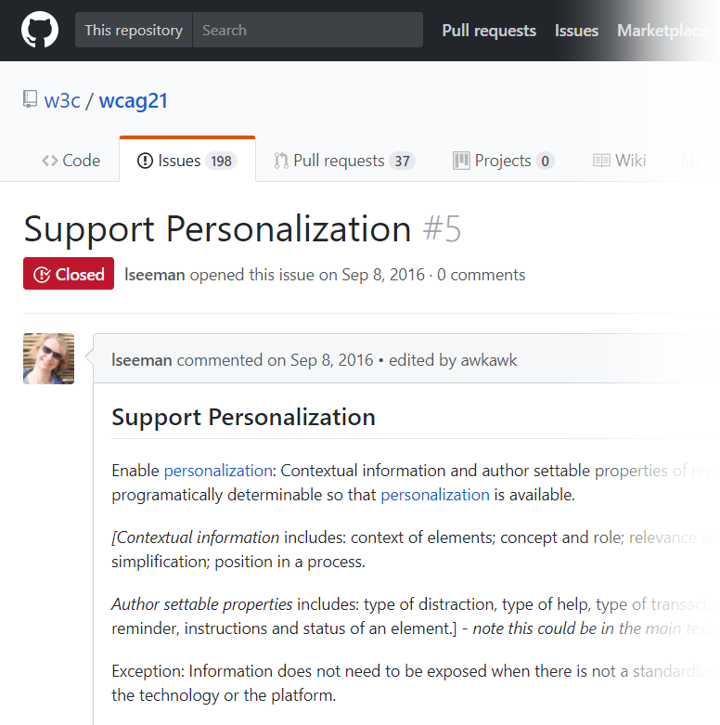
Support Personalization
Critical need for users with cognitive issues
Personalization involves tailoring aspects of the user experience to meet the preferences or needs of the user.
Emergent Personalization Semantics 1.0 Rec. @ W3C (source: https://www.w3.org/TR/personalization-semantics-1.0/)

Slide 14

Original Proposed Success Criteria from COGA TF
Enable Personalization: Contextual information and author settable properties of regions and elements are programmatically determinable, so that personalization is available.
Suggestion for Priority Level (A)
(source: https://github.com/w3c/wcag21/issues/5)

Slide 15
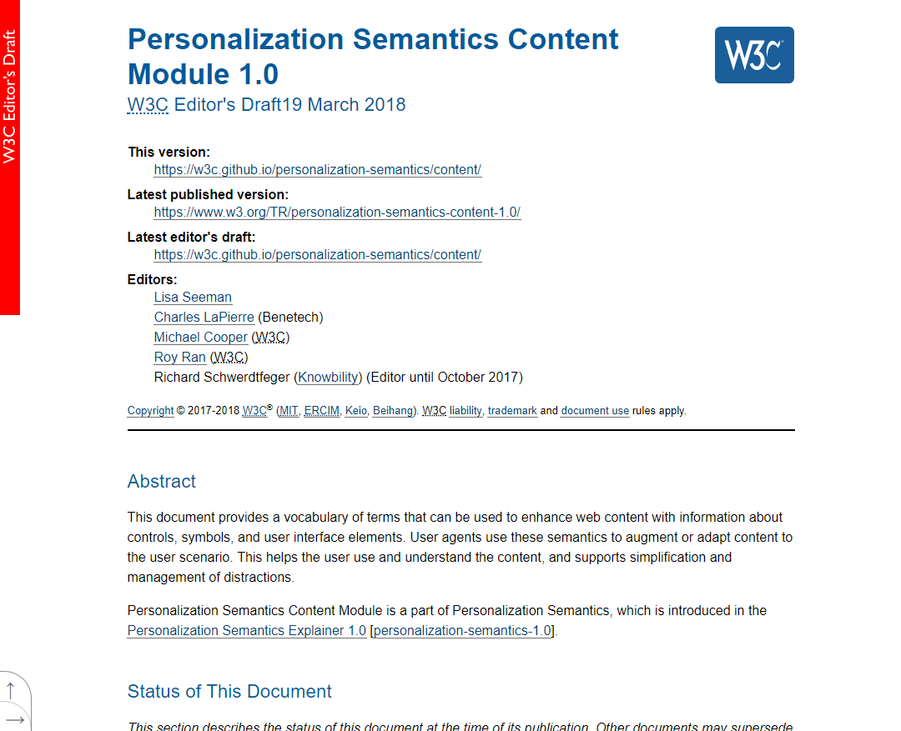
Personalization Semantics 1.0
Pros:
Built-for-Purpose specification
Focused on creating a rich Taxonomy for Personalization
Cons:
Still in Draft status
Steep learning curve
No real-world support today

Slide 16

A, AA, AAA
whether the Success Criterion is essential (in other words, if the Success Criterion isn't met, then even assistive technology can't make content accessible)
whether it is possible to satisfy the Success Criterion for all Web sites and types of content that the Success Criteria would apply to (e.g., different topics, types of content, types of Web technology)
whether the Success Criterion requires skills that could reasonably be achieved by the content creators (that is, the knowledge and skill to meet the Success Criteria could be acquired in a week's training or less)
whether the Success Criterion would impose limits on the "look & feel" and/or function of the Web page. (limits on function, presentation, freedom of expression, design or aesthetic that the Success Criteria might place on authors)
whether there are no workarounds if the Success Criterion is not met

Slide 17

Crawling before running
Create 2 S.C. – one at AA, and on at AAA
AA Success Criteria
Limited (constrained) list of functions and inputs
Use existing technologies
of functions and
AAA Success Criteria
Use Personalization Semantics

Slide 18
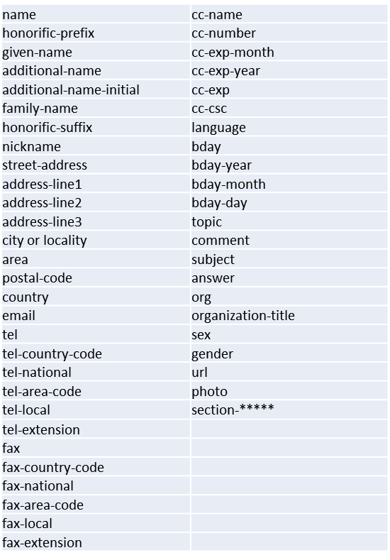
Success Criterion 1.3.4 Identify Common Purpose (AA)
The meaning of each input field collecting information about the user can be programmatically determined when:
The input field has a meaning that maps to the HTML 5.2 Autofill field names;
The input field has a meaning that maps to one of the identified conventional field types* and
The content is implemented using technologies with support for identifying the expected meaning for form input data.

Slide 19
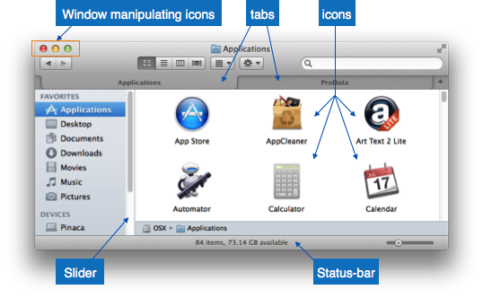
Success Criterion 1.3.5 Identify Purpose(AAA)
In content implemented using markup languages, the purpose of User Interface Components, icons, and regions can be programmatically determined.

Slide 20
Programmatically Determined (Programmatically Determinable)
determined by software from author-supplied data provided in a way that different user agents, including assistive technologies, can extract and present this information to users in different modalities

Slide 21

At Risk (March 2018)
Draft language needed fuller review
External dependencies
Demonstrate ability to implement & show value

Slide 22
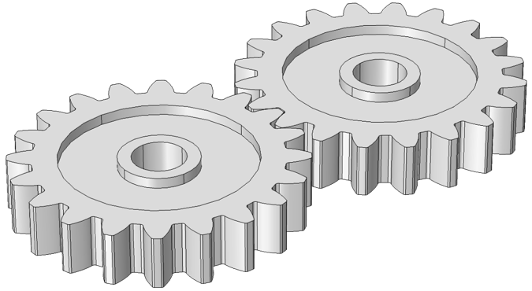
Identify Common Purpose (1.3.4)
Breaking down the technical need:
A publicly published metadata schema
A means of attaching metadata values at the element level
Demonstrating the value of attaching the metadata

Slide 23
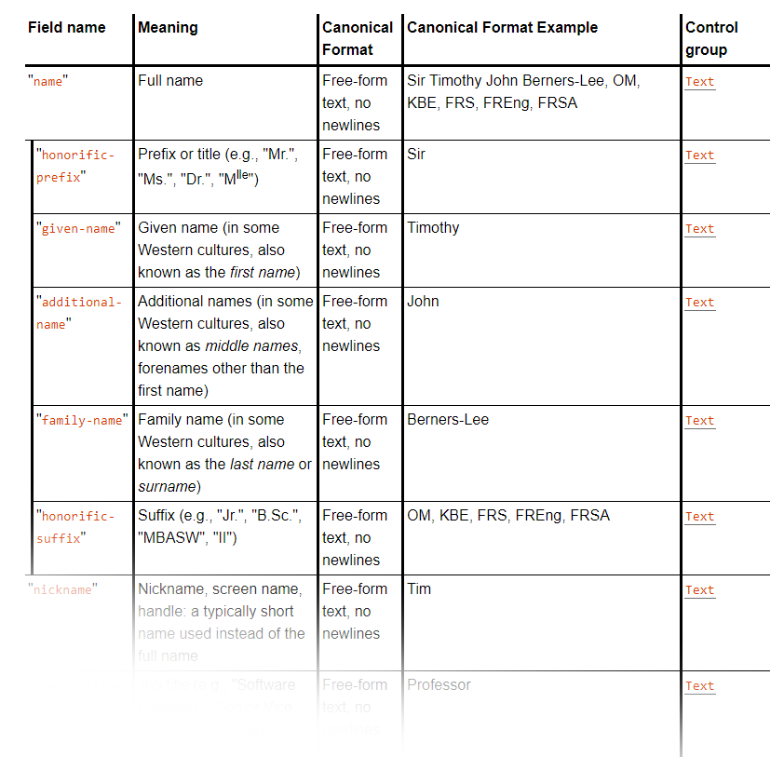

1) Publicly Published Schema – HTML5 Autofill Tokens
Autofilling form controls: the autocomplete attribute
“User agents sometimes have features for helping users fill forms in, for example prefilling the user’s address based on earlier user input.”
The autocomplete content attribute can be used to hint to the user agent how to, or indeed whether to, provide such a feature. (source: https://www.w3.org/TR/html51/sec-forms.html#sec-autofill)

Slide 24
2) Attaching the Metadata - Using Autocomplete
<fieldset>
<legend>Ship the blue gift to...</legend>
<p>
<label> Address:
<input name="address" autocomplete="street-address"> </label>
<p>
<label> City:
<input name="city" autocomplete="address-level2"> </label>
<p>
<label> Postal Code:
<input name="postal-code" autocomplete="postal-code"> </label>
</fieldset>
(source: https://www.w3.org/TR/html51/sec-forms.html#sec-autofill)

Slide 25
3) Ability to implement & show value
Fixed strings of predictable text are useful
CSS selectors: [autocomplete=“fixed term”] {
/* style it */
}
Can also be used with client-side scripting:
element.getAttribute(attributename)- Javascript $("[attribute=value]")- jQuery

Slide 26
Identify Purpose (1.3.5 )
Breaking down the technical need:
A publicly published metadata schema
A means of attaching metadata values at the element level
Demonstrating the value of attaching the metadata

Slide 27
Status:
Implementation depends on Personalization (Draft) Spec. (taxonomy) becoming final
Demonstration of implement-ability and value is at Proof-of-Concept stage
New technology requires learning curve = slow adoption

Slide 28
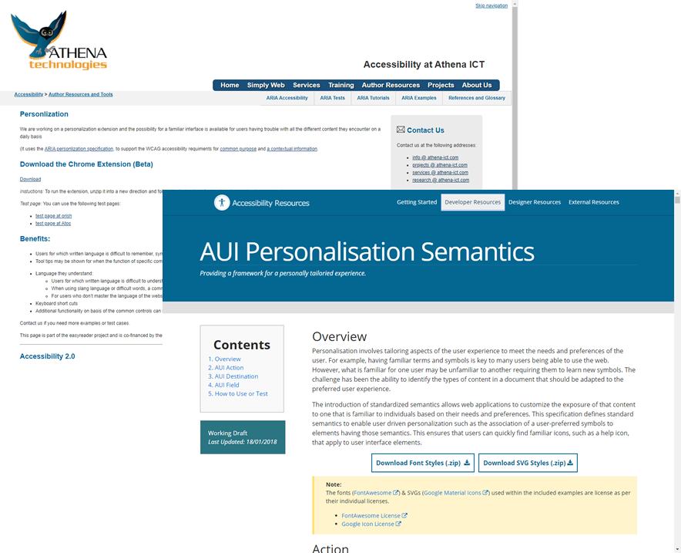
Demonstration of implement-ability
Proof-of-concept examples exist using Draft aui-* attributes.
AUI Action (+ values)
AUI Destination (+ values)
AUI Field (+ values)

Slide 29
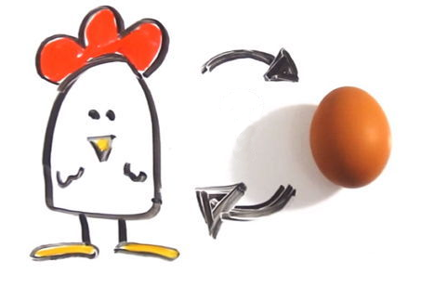
Now what?
Tooling!

Slide 30

A Deque Extension for SC 1.3.4
Adds icons to form inputs with @autocomplete
Limited set of form inputs (Proof of concept)
Download a copy here:
https://github.com/dequelabs/ Form-Personalization
Calling all hackers, tinkerers, and experimenters…

Slide 31
Questions?
Thank you!
John Foliot john.foliot@deque.com
Chris McMeeking
chris.mcmeeking@deque.com

